Slide 1
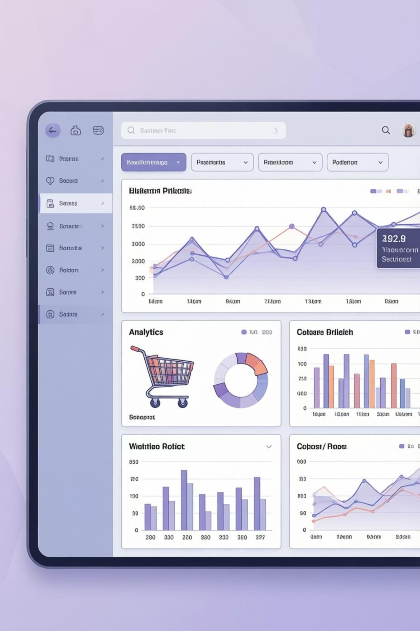
Customer Shopping Behavior Analysis
Uncovering insights from 3,900 purchases to drive strategic business decisions

Slide 2
DATASET OVERVIEW
The Foundation
3,900
18
37
Total Purchases
Data Points
Missing Values
Transactions analyzed
Features per customer
In review ratings only
Customer Demographics
Shopping Behavior
Age, Gender, Location
Purchase patterns & frequency
Subscription Status
Discounts & promo codes
Review ratings & shipping

Slide 3

PYTHON ANALYSIS
Data Preparation Pipeline
01
02
Data Loading & Exploration
Missing Data Handling
Imported dataset, checked structure with df.info() and summary statistics
Imputed Review Rating nulls using median rating per product category
03
04
Column Standardization
Feature Engineering
Renamed columns to snake_case for consistency
Created age_group bins and purchase_frequency_days columns
05
06
Data Consistency
Database Integration
Verified redundancy, dropped promo_code_used column
Connected to PostgreSQL and loaded cleaned data

Slide 4
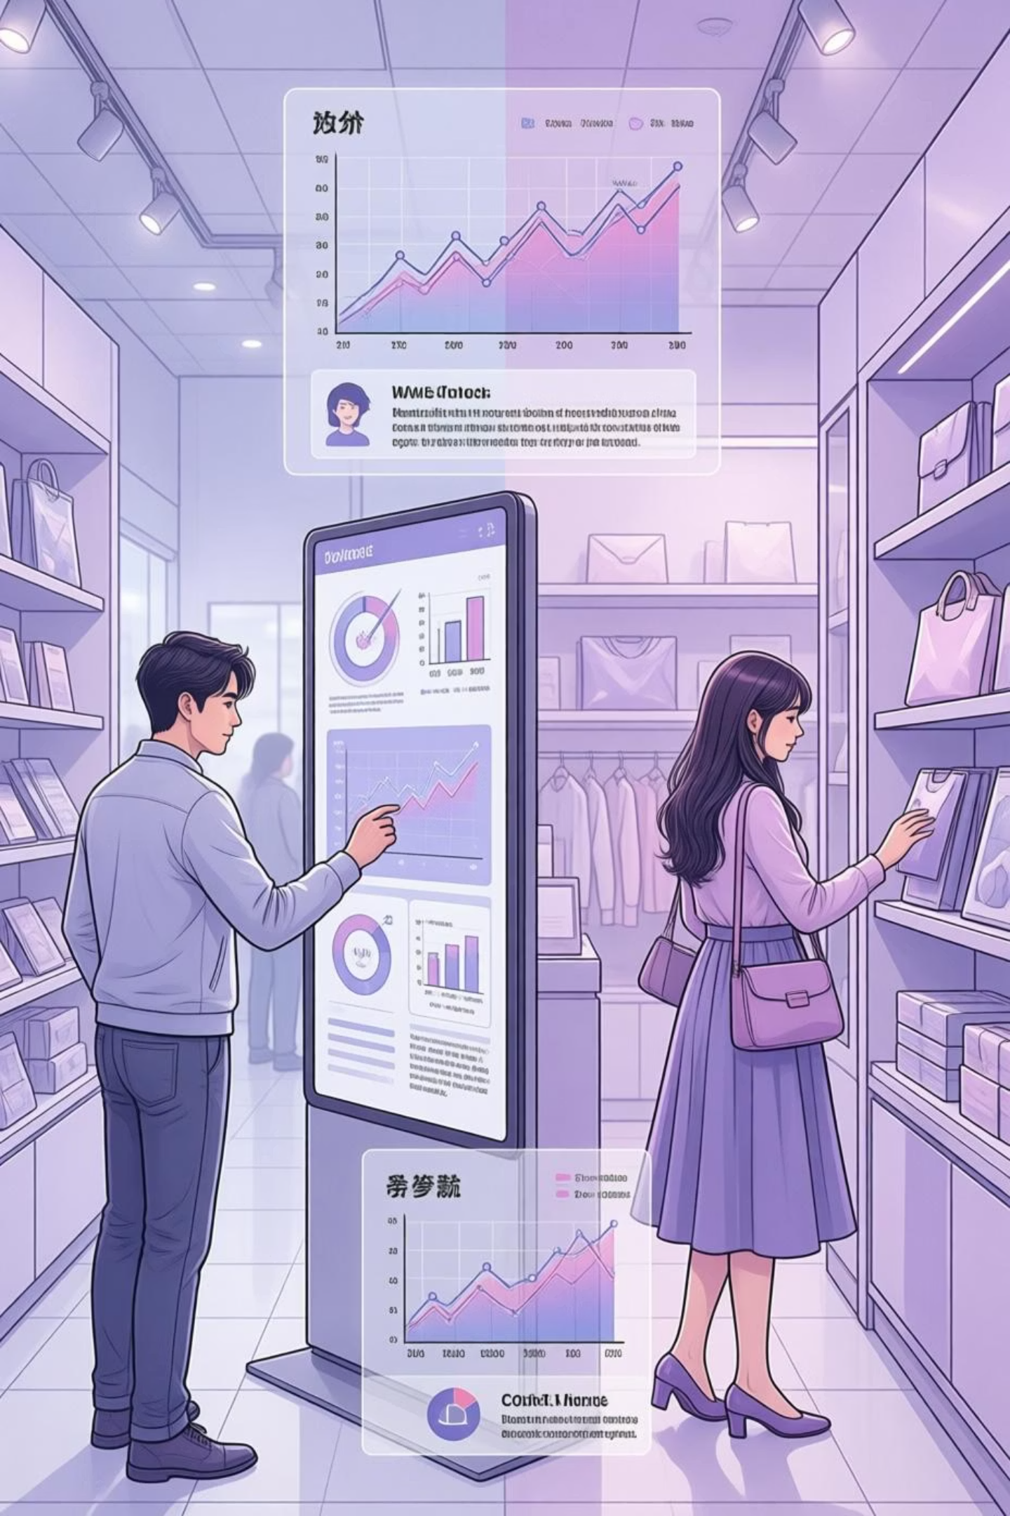
SQL ANALYSIS
Revenue by Gender
Compared total revenue generated by male vs. female customers to identify gender-based spending patterns and opportunities for targeted marketing.
Key Insight
Gender segmentation reveals distinct purchasing behaviors

Slide 5
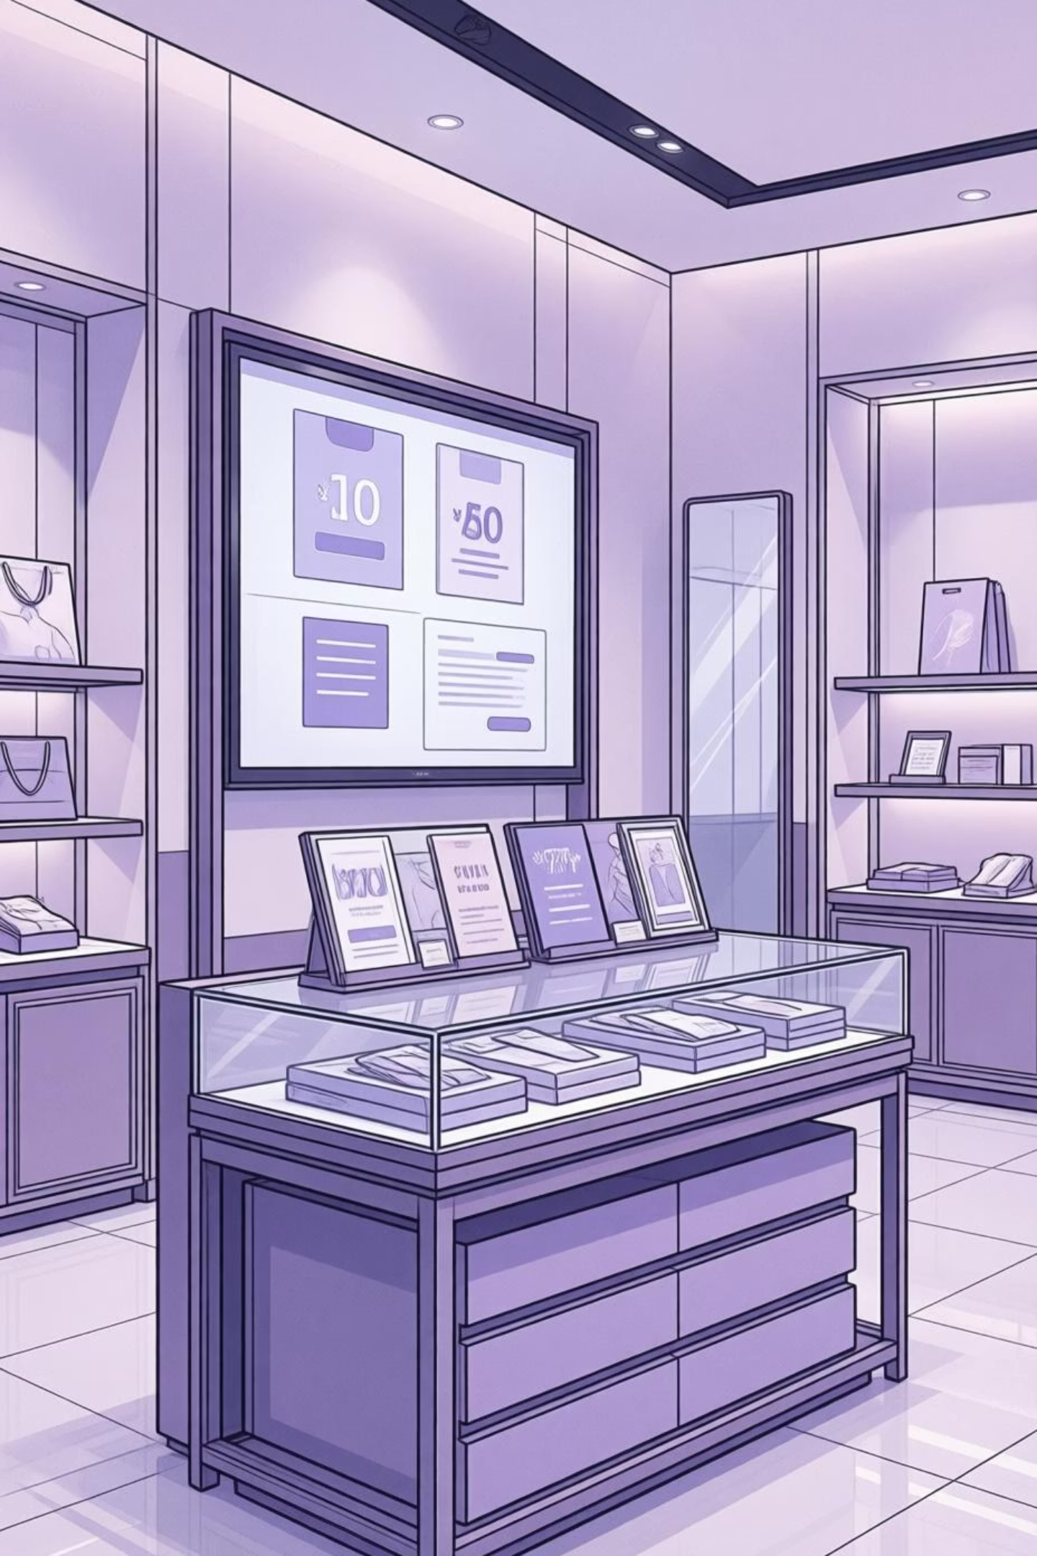



High-Value Discount Users
Smart Spenders
Prime Segment
Customers using discounts while spending above average
Value-conscious but high-spending customer group
Opportunity
Potential for loyalty program enrollment

Slide 6
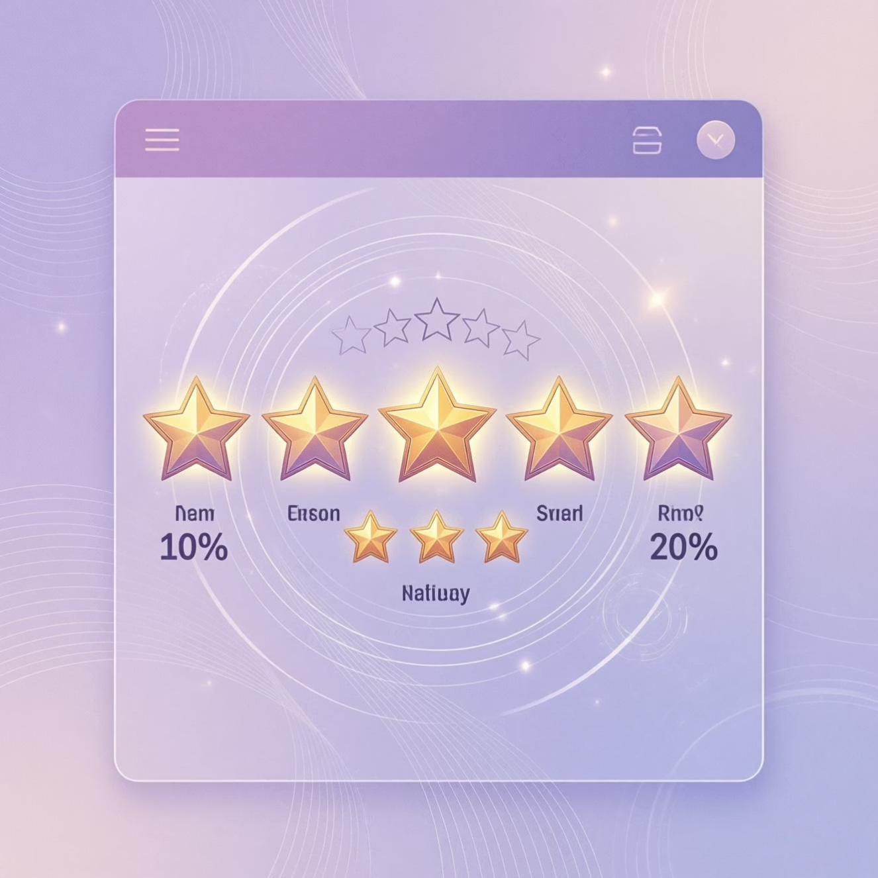

Product Performance Insights
Top 5 Products by Rating
Shipping Type Comparison
Highest average review ratings identify customer favorites and quality leaders
Standard vs. Express shipping purchase amounts reveal customer urgency patterns

Slide 7



SUBSCRIPTION ANALYSIS
Subscribers vs. Non-Subscribers
2.3x
68%
5+
Higher Spend
Repeat Rate
Purchase Threshold
Average purchase amount for subscribers
Subscribers make more frequent purchases
Customers with 5+ purchases more likely to subscribe
Subscribers demonstrate significantly higher lifetime value and purchase frequency

Slide 8



Customer Segmentation
Loyal
1
10+ purchases
Returning
2
2-9 purchases
New
3
1 purchase
Discount-Dependent Products
Revenue by Age Group
Top 5 products with highest percentage of discounted purchases
Total revenue contribution across customer age segments

Slide 9
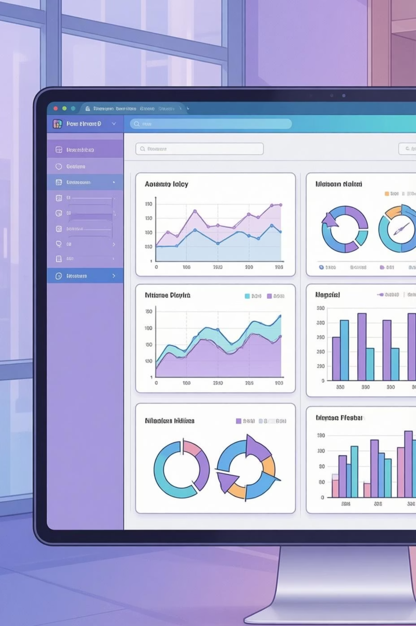
POWER BI
Interactive Dashboard
Comprehensive visual analytics bringing all insights together in an interactive format for real-time decision making

Slide 10

STRATEGIC RECOMMENDATIONS
Action Plan
1
2
3
Boost Subscriptions
Customer Loyalty Programs
Review Discount Policy
Promote exclusive benefits and perks for subscribers
Balance sales boosts with margin control
Reward repeat buyers to move them into "Loyal" segment
4
5
Product Positioning
Targeted Marketing
Highlight top-rated and best-selling products in campaigns
Focus on high-revenue age groups and express-shipping users

